Slide 1
Databases – Part 2
Data Persistence and the Room API
Firebase

Slide 2
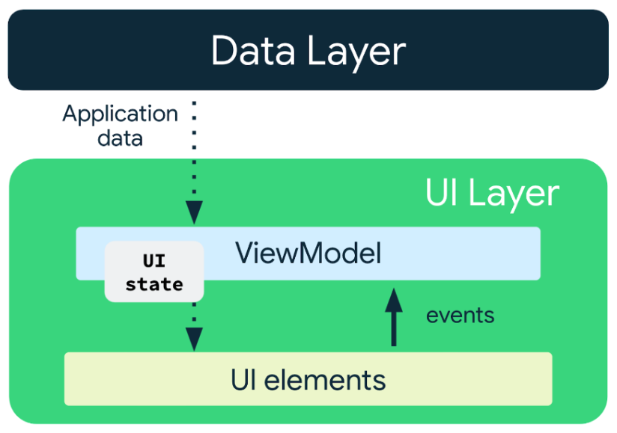
ViewModel
What is a ViewModel?
It manages the User Interface state
https://developer.android.com/topic/libraries/architecture/viewmodel
A ViewModel is a part of the Android Architecture Components, a set of libraries and guidelines provided by Google to help developers create robust and maintainable Android applications.
Image source
Google's ViewModel Documentation
A ViewModel is specifically designed to store and manage UI-related data and business logic in a lifecycle-aware way​
Separate from the UI code itself – Separation of Concerns​
The ViewModel acts as a "middleman" between the data source and the UI​
The data source can be remotely accessed – for example, a web-service​

Slide 3
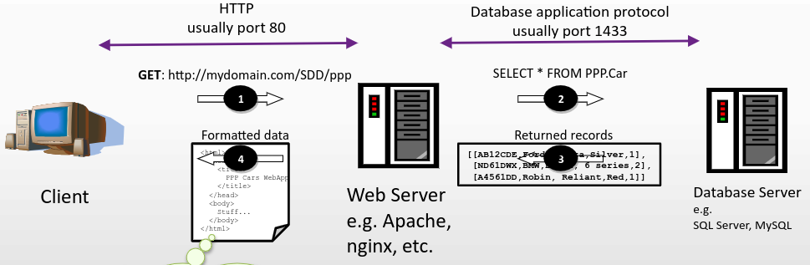
Local versus Remote data persistence
Firebase is a cloud-based database service – requires internet access
Most SQL databases require a network connection, whether they're considered cloud-based or not!

Slide 4
Room API

Slide 5
Room Persistence Library
The Room persistence library provides an abstraction layer over SQLite to allow fluent database access while harnessing the full power of SQLite
Room provides the following benefits:
Compile-time verification of SQL queries
Convenience annotations that minimize repetitive and error-prone code
Streamlined database migration paths

Slide 6
Room API Pattern
In the example, you will observe a pattern:
Create data class(es) – the entities
Create DAO(s) – data access object(s)
Create a database – a class that extends RoomDatabase that manages access to the DAOs
Optional (and recommended) create a ViewModel to hold the UI state dependent on the database data
UI elements as required

Slide 7
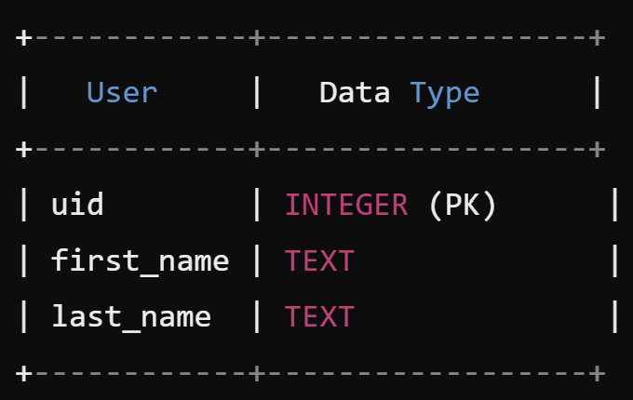
Data Entity
User data entity: Each instance of User represents a row in a user table in the app's database
@Entity
public class User {
@PrimaryKey
public int uid;
@ColumnInfo(name = "first_name")
public String firstName;
@ColumnInfo(name = "last_name")
public String lastName;
}

Slide 8
Data Access Object (DAO)
User DAO: Provides the methods that the rest of the app uses to interact with data in the user table
@Dao
public interface UserDao {
@Query("SELECT * FROM user")
List<User> getAll();
@Query("SELECT * FROM user WHERE uid IN (:userIds)")
List<User> loadAllByIds(int[] userIds);
@Query("SELECT * FROM user WHERE first_name LIKE :first AND " +
"last_name LIKE :last LIMIT 1")
User findByName(String first, String last);
@Insert
void insertAll(User... users);
@Delete
void delete(User user);
}

Slide 9
Database
AppDatabase defines the database configuration and serves as the app's main access point to the persisted data
The database class must satisfy the following conditions:
The class must be annotated with a @Database annotation that includes an entities array that lists all of the data entities associated with the database
The class must be an abstract class that extends RoomDatabase
For each DAO class that is associated with the database, the database class must define an abstract method that has zero arguments and returns an instance of the DAO class
@Database(entities = {User.class}, version = 1)
public abstract class AppDatabase extends RoomDatabase {
public abstract UserDao userDao();
}

Slide 10
Usage
After you have defined the data entity, the DAO, and the database object, you can use the following code to create an instance of the database:
AppDatabase db = Room.databaseBuilder(getApplicationContext(),
AppDatabase.class, "database-name").build();
You can then use the abstract methods from the AppDatabase to get an instance of the DAO. In turn, you can use the methods from the DAO instance to interact with the database:
UserDao userDao = db.userDao();
List<User> users = userDao.getAll();

Slide 11
Usage
Insert users
UserDao userDao = db.userDao();
User user1 = new User();
user1.uid = 1;
user1.firstName = "John";
user1.lastName = "Doe";
User user2 = new User();
user2.uid = 2;
user2.firstName = "Jane";
user2.lastName = "Smith";
userDao.insertAll(user1, user2);

Slide 12
Room Persistence Example
https://developer.android.com/codelabs/android-room-with-a-view#0

Slide 13
Firebase

Slide 14
Firebase sign in
To allow user sign-in using Firebase in an Android app, you’ll need to follow these general steps:
Set Up Firebase Project:
Create a Firebase project in the Firebase Console https://console.firebase.google.com/).
Add your Android app to the project by providing the package name and downloading the google-services.json file
Place this file in the app module of your Android project

Slide 15
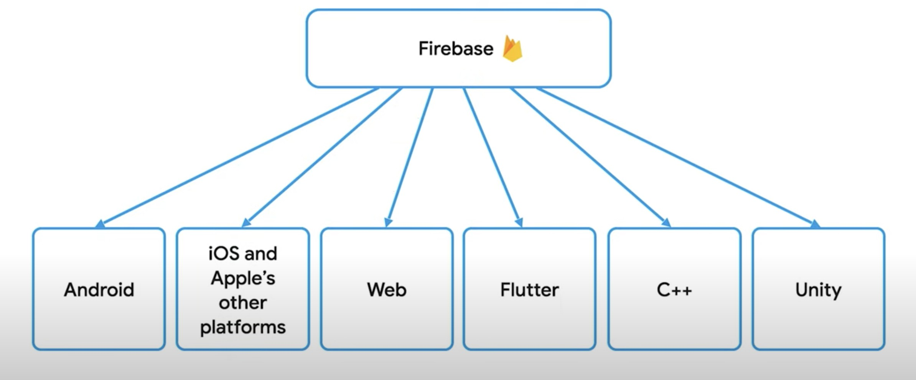
Firebase Project and firebase app
Figure 1: Firebase Project

Slide 16
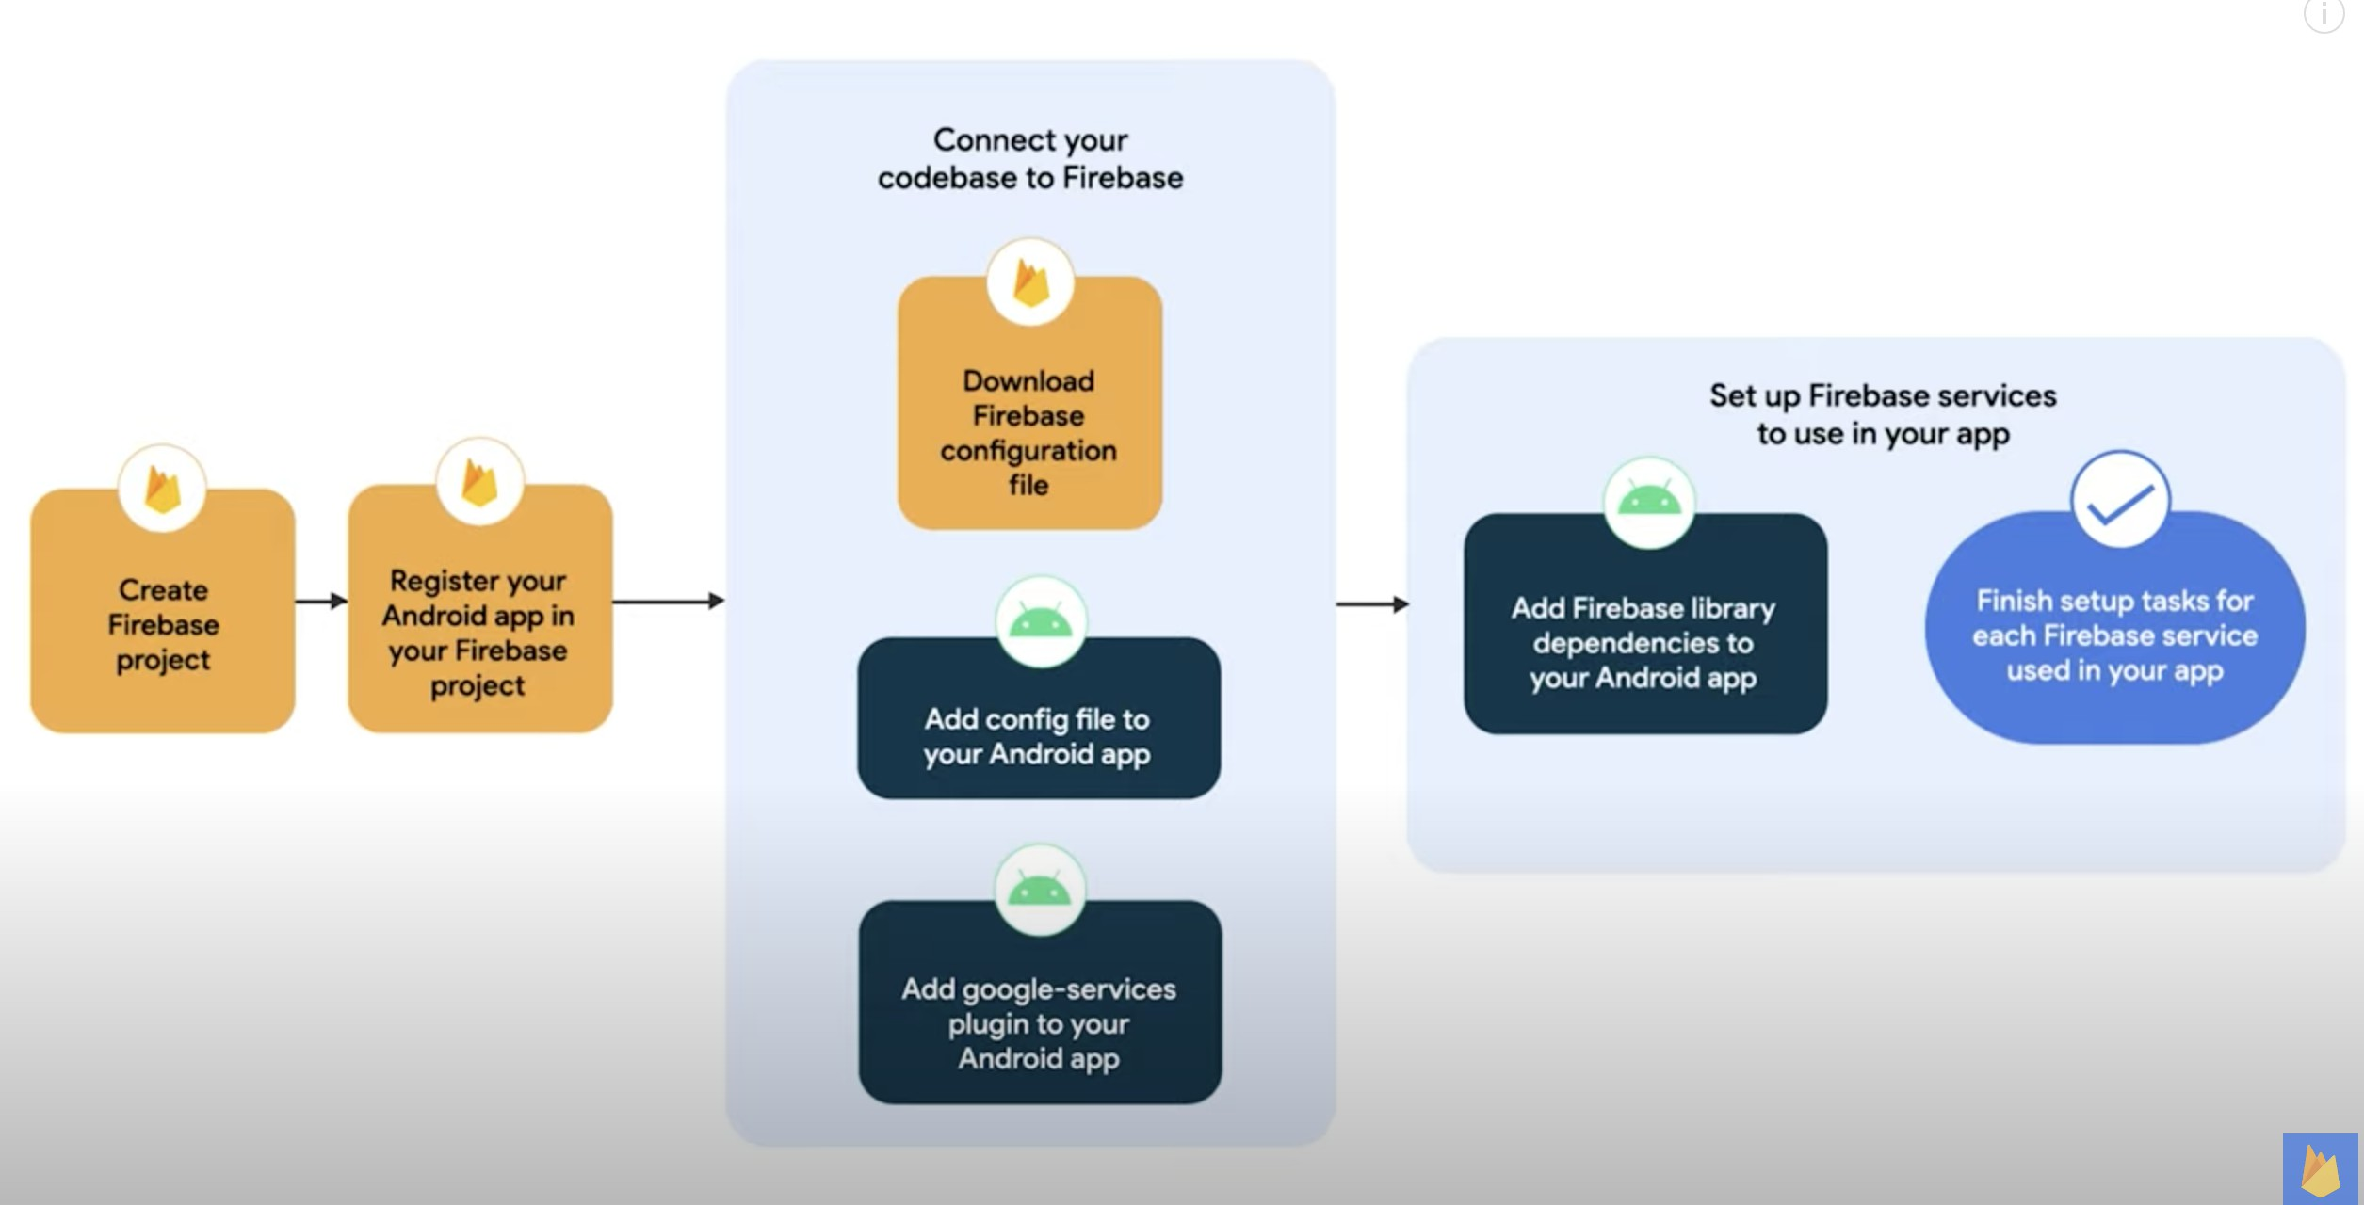
Workflow
Figure 2: Workflow

Slide 17
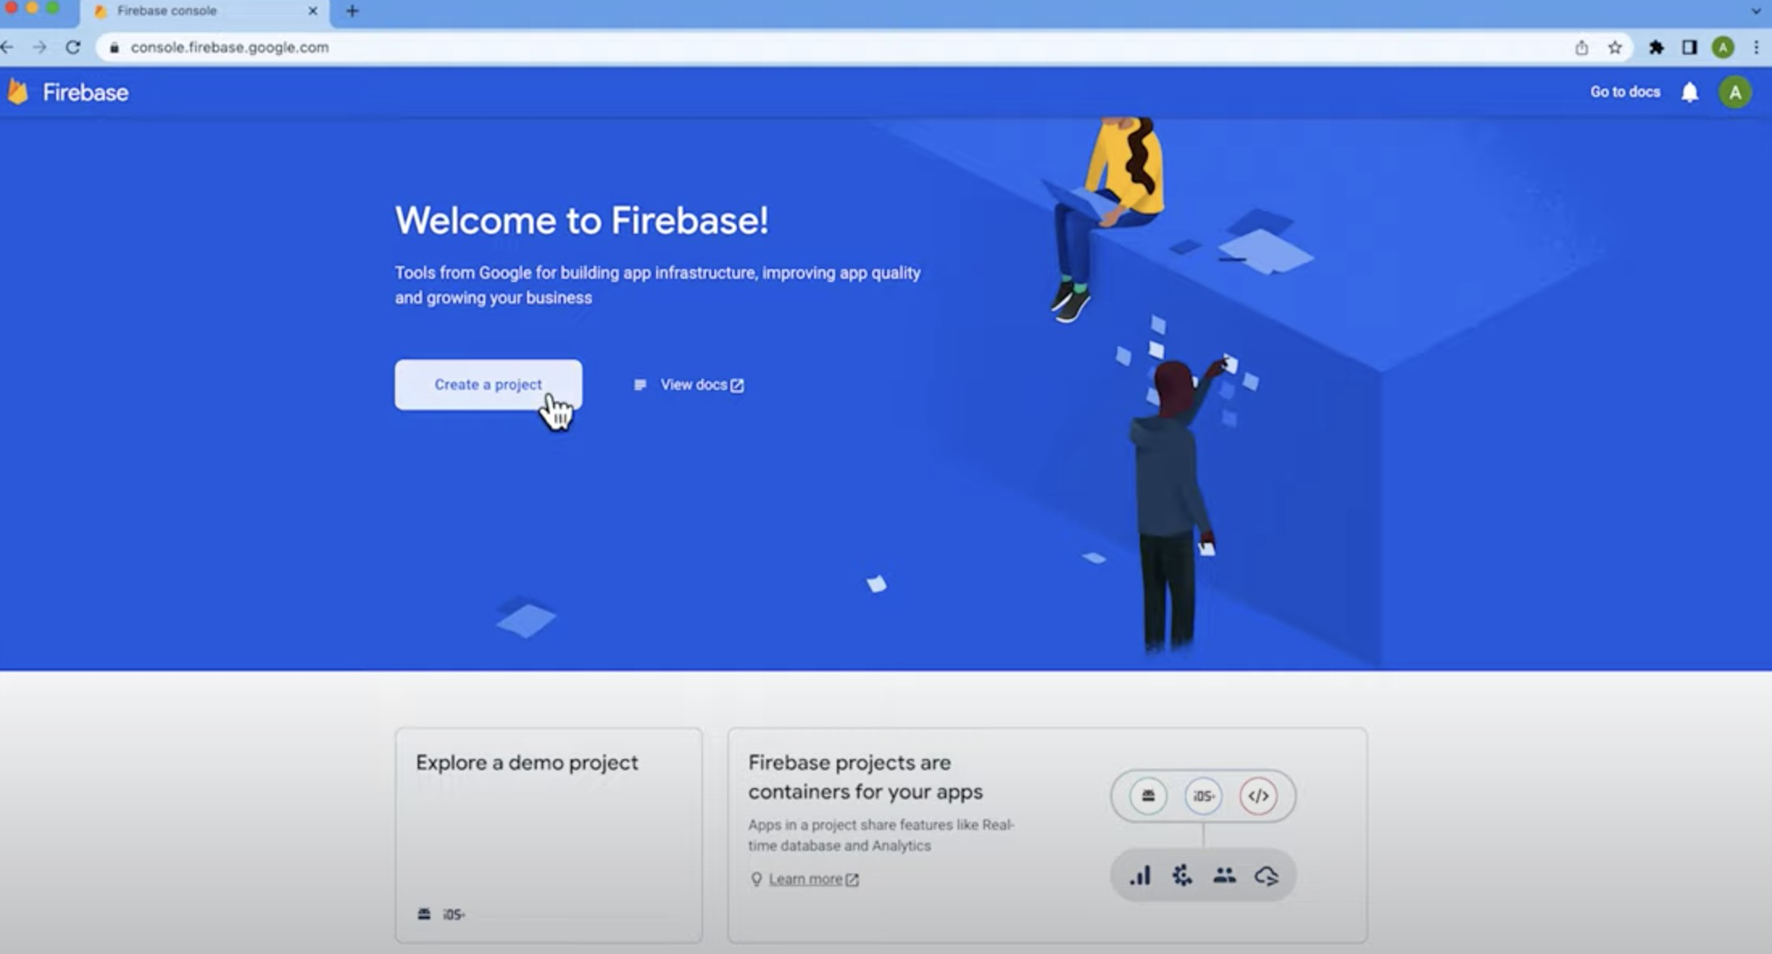
Firebase console
Figure 3: Console

Slide 18
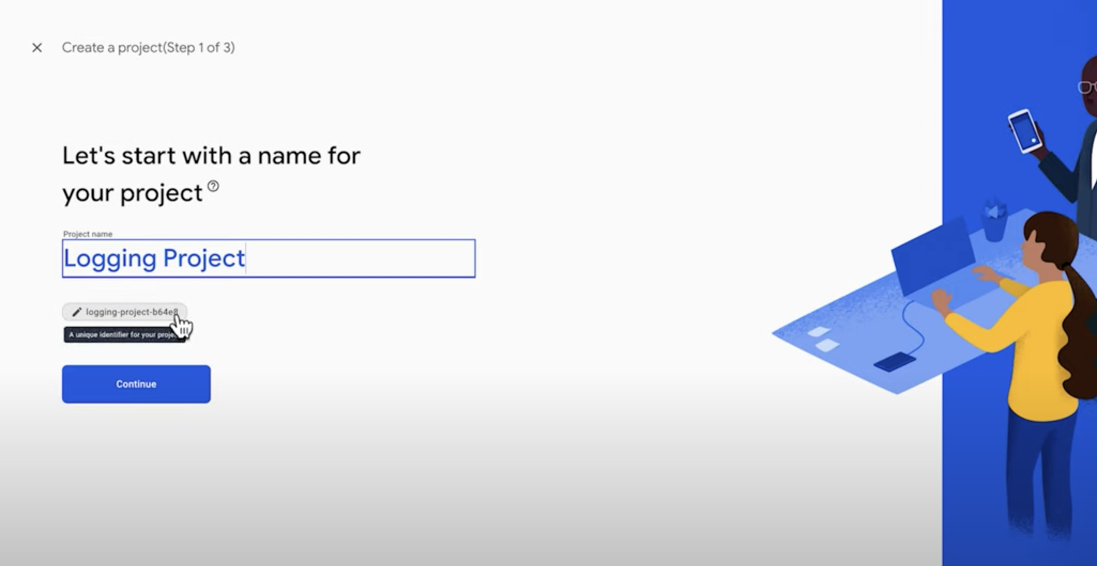
Create a Firebase project
Figure 4: Get a unique name

Slide 19
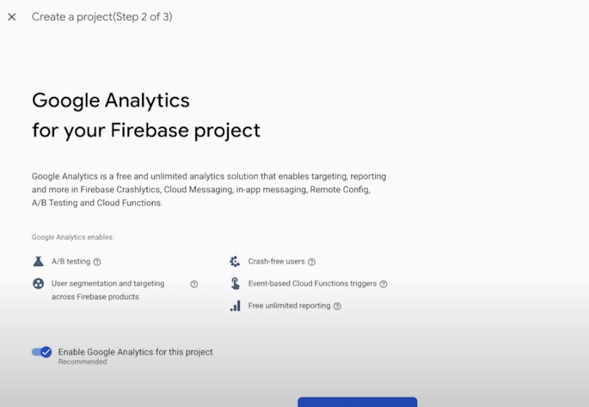
Enable Google Analytics

Slide 20
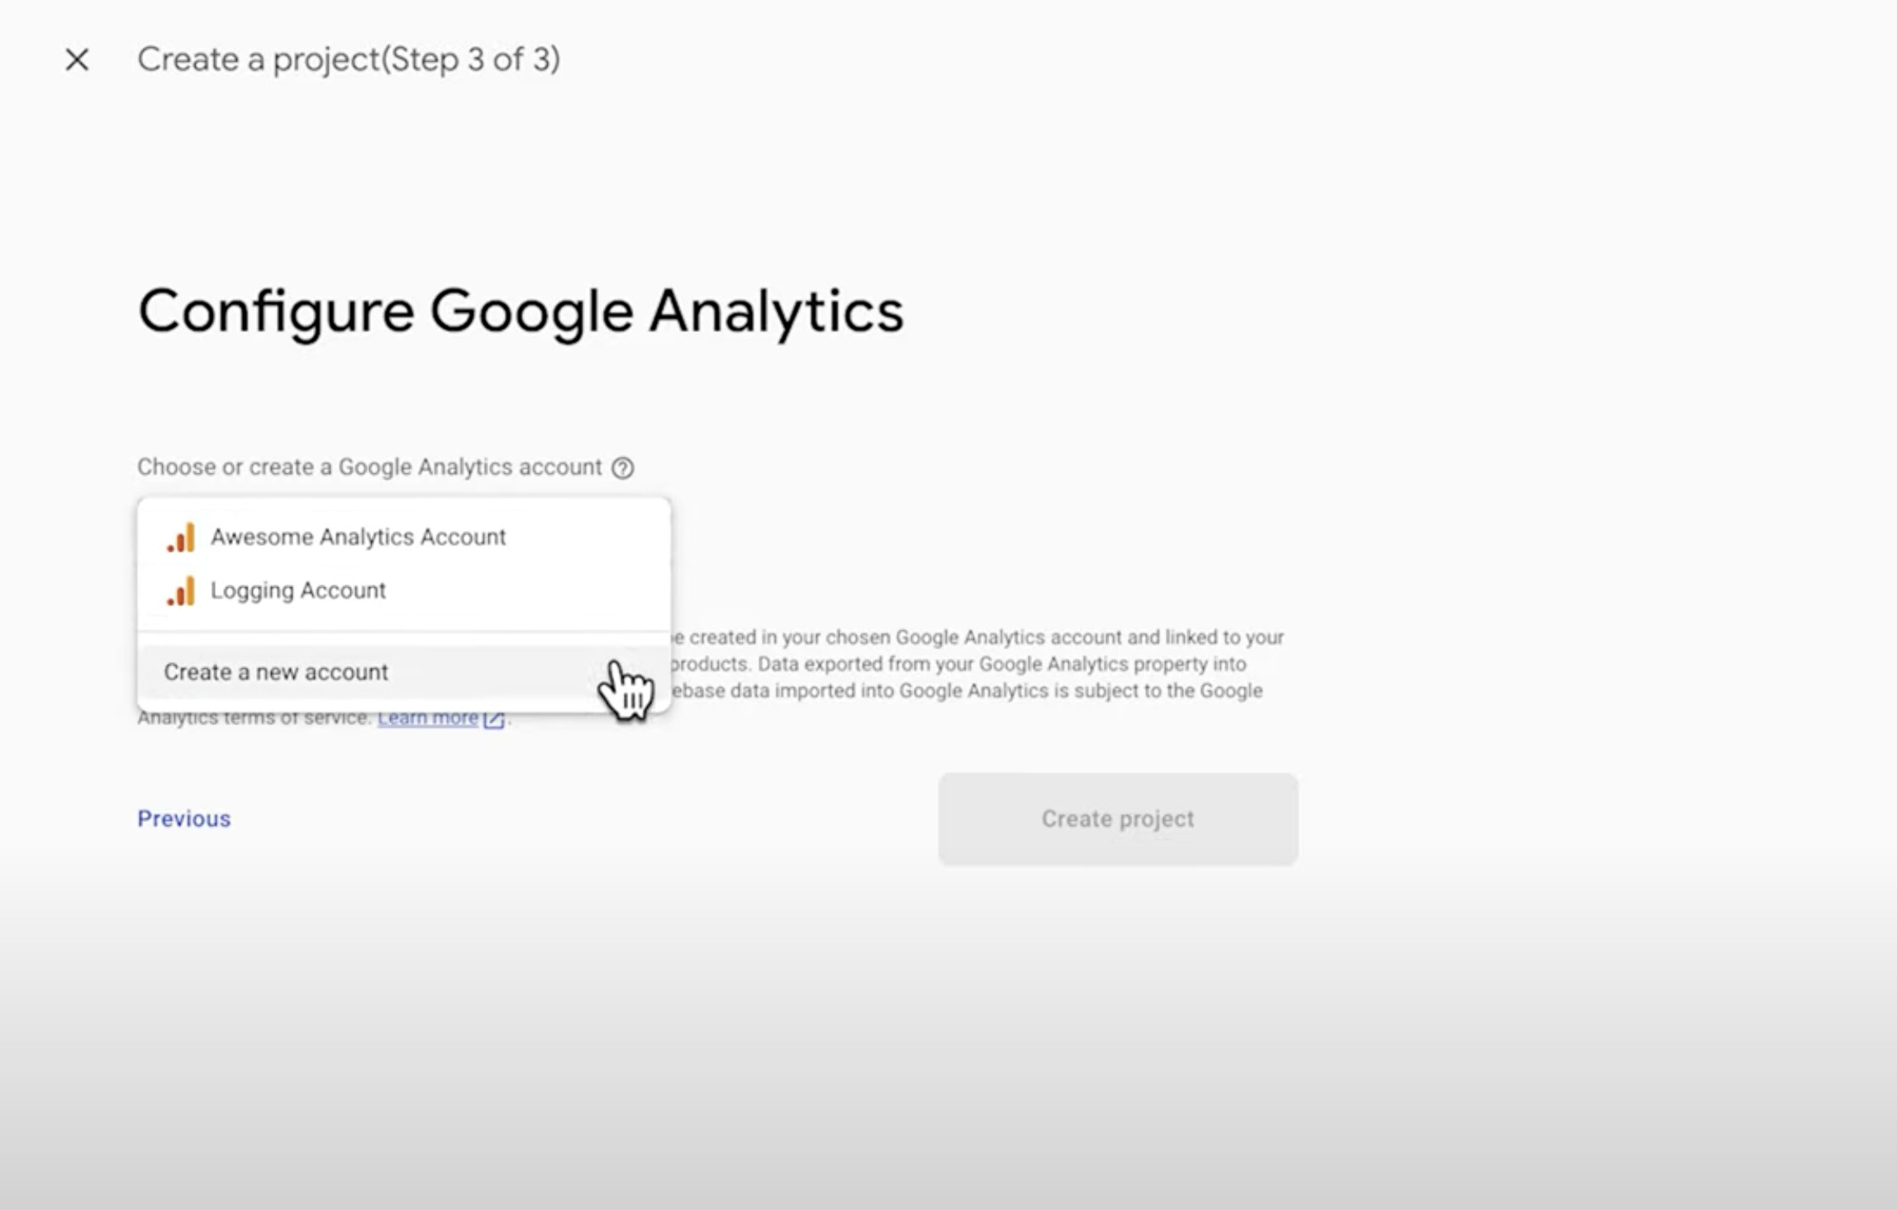
Configure Google Analytics

Slide 21
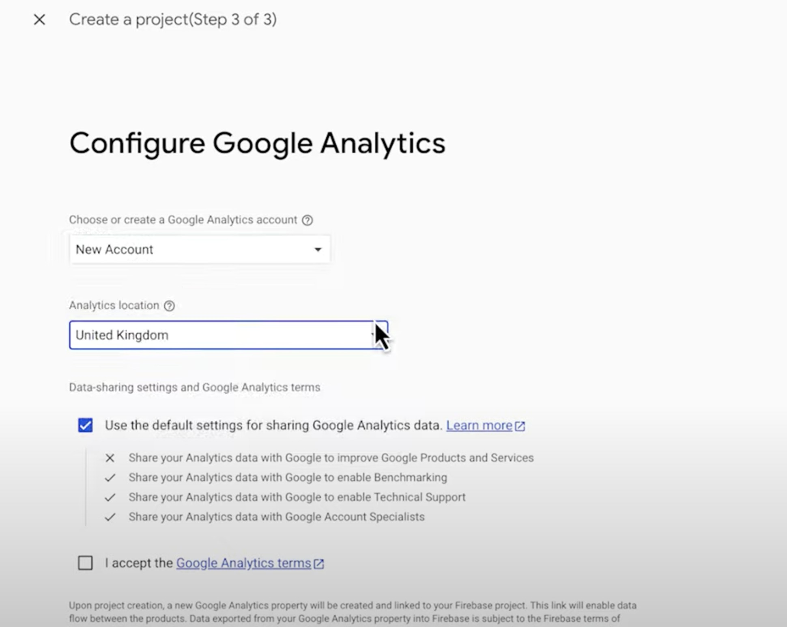
Configure

Slide 22
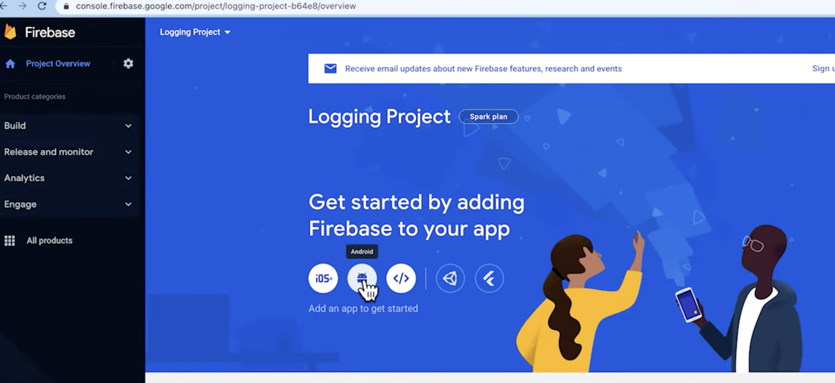
Back to the console

Slide 23
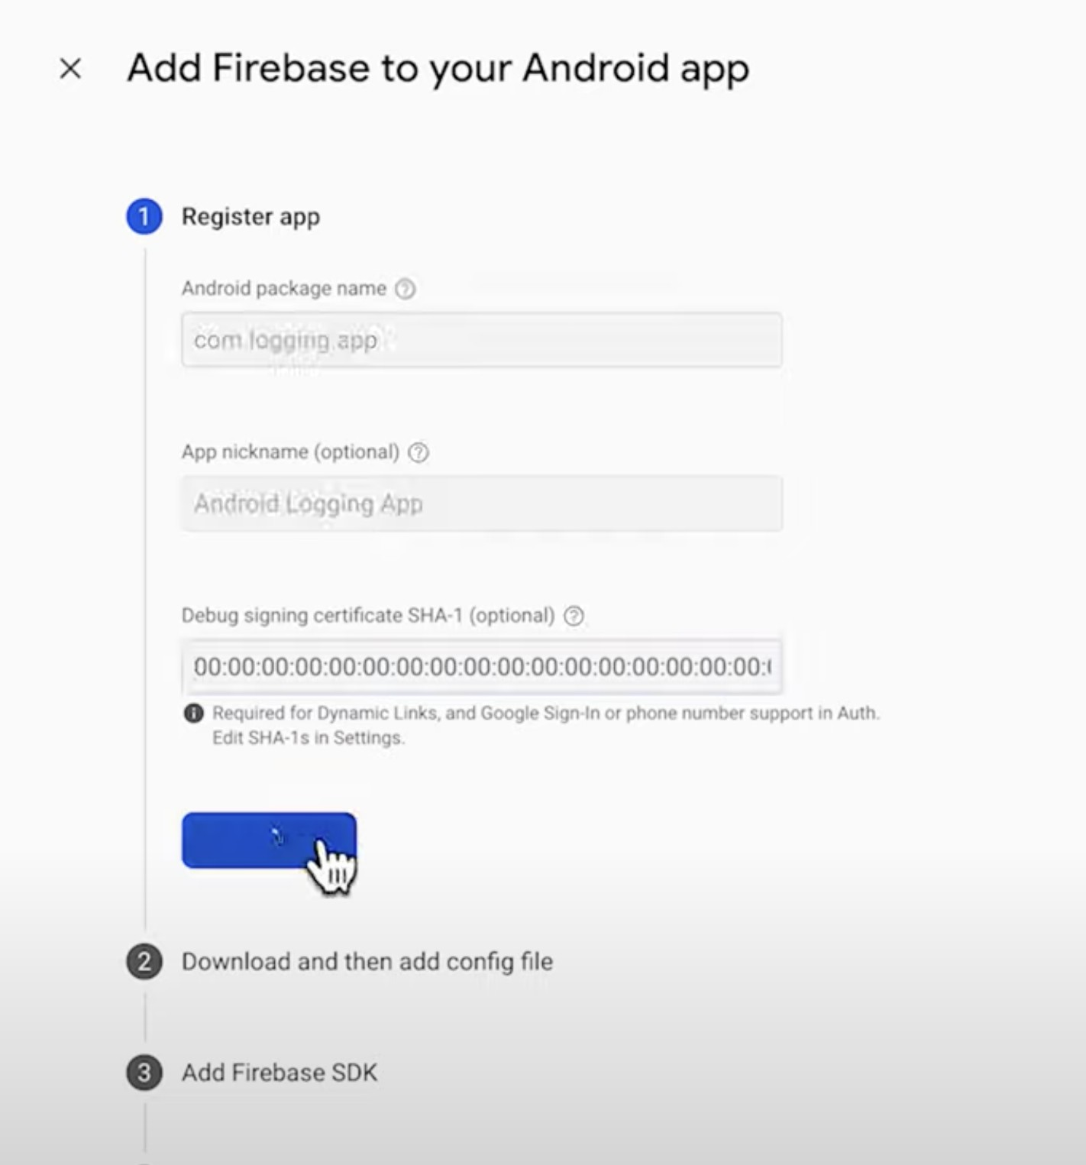
Register the app

Slide 24
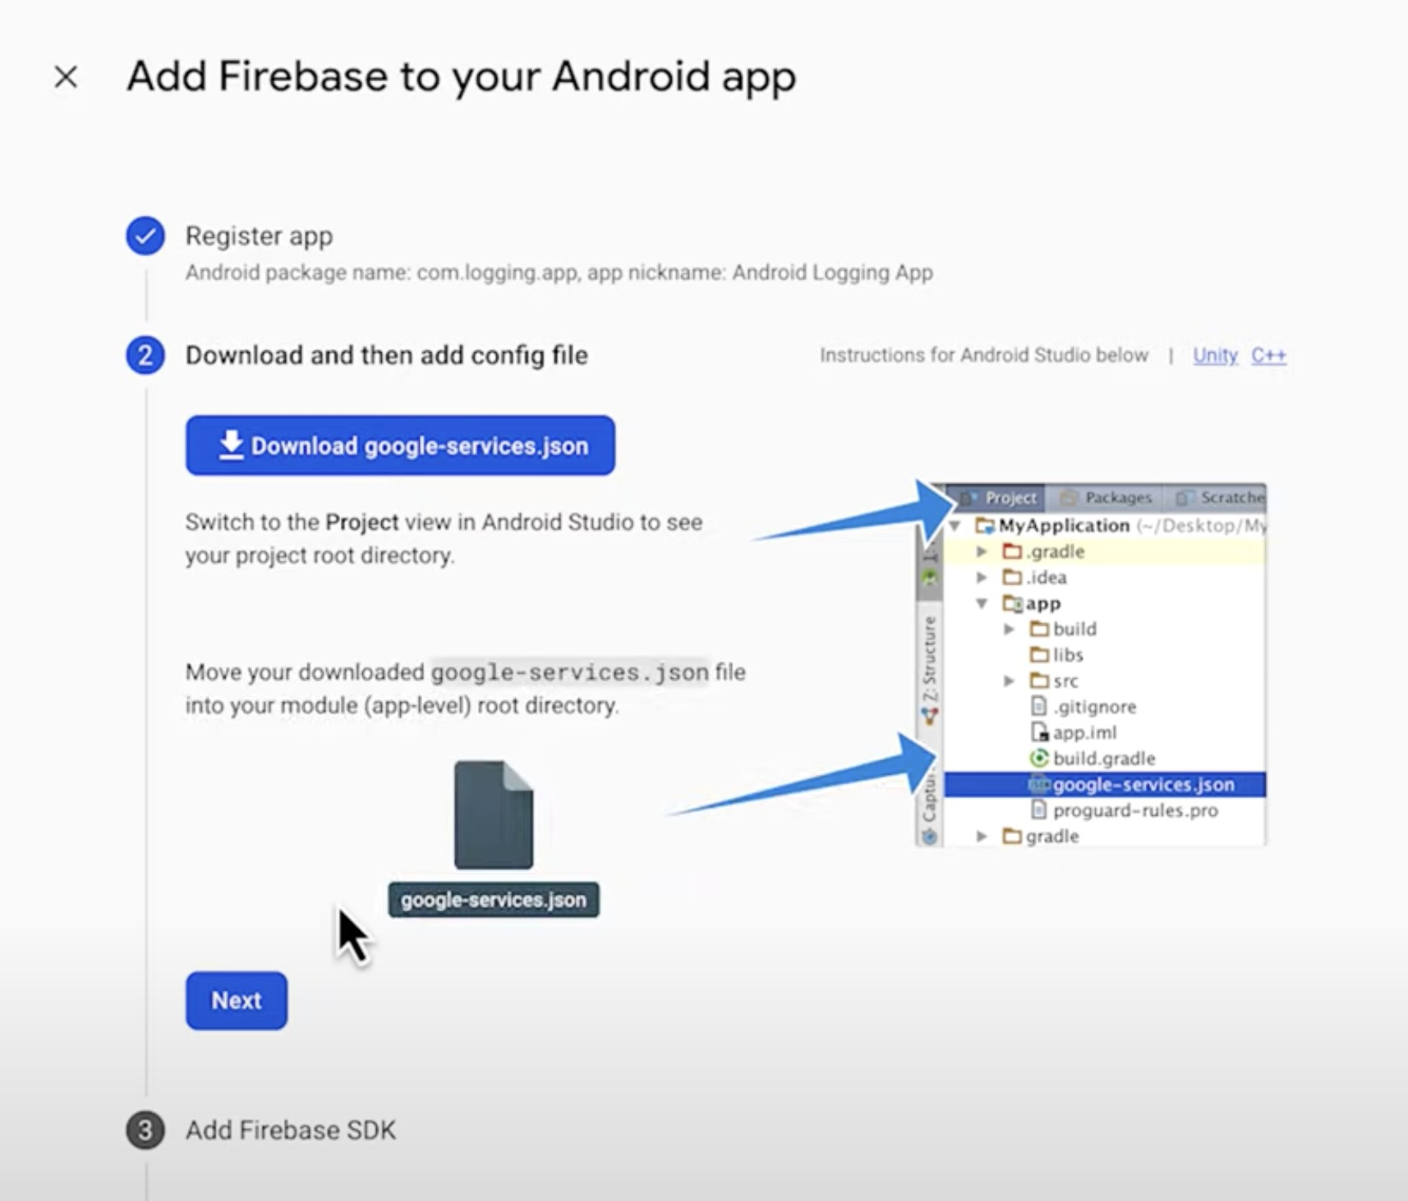
Get the json file

Slide 25
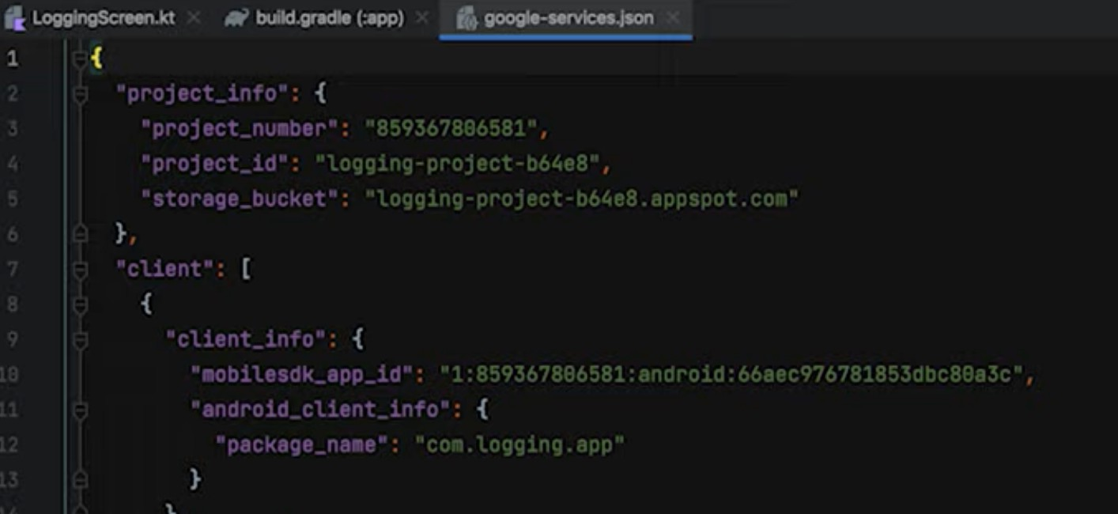
The looks of the Json file

Slide 26
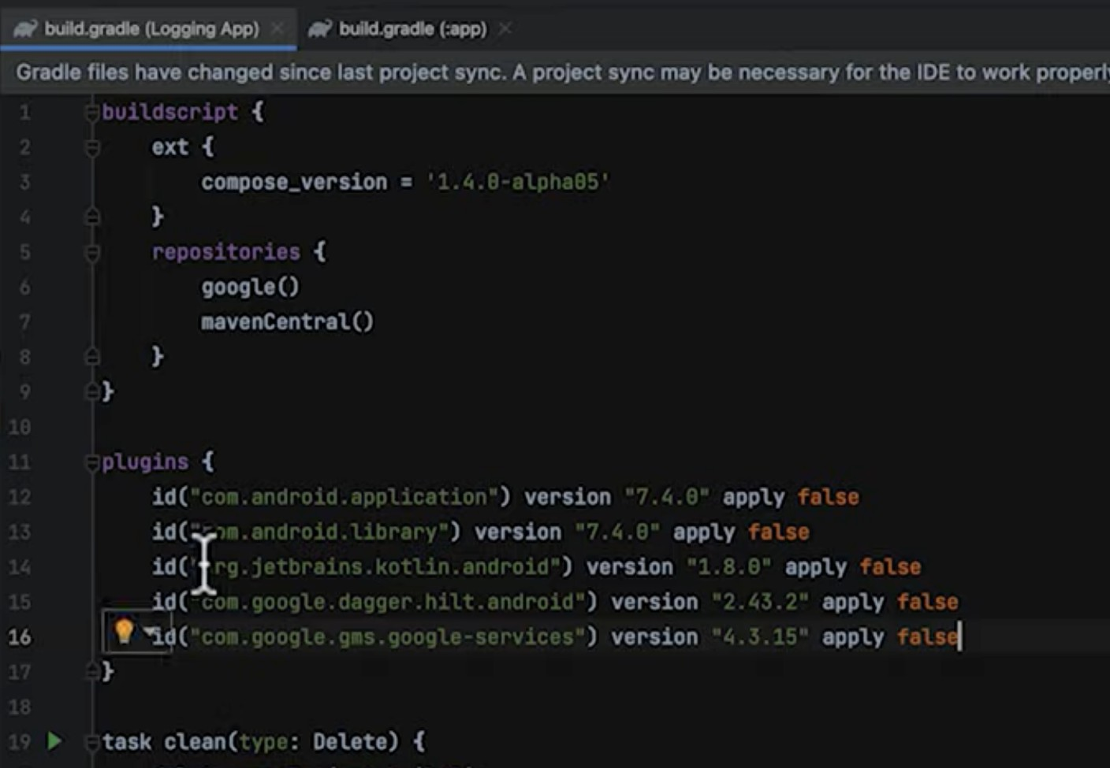
Modifying Gradle

Slide 27
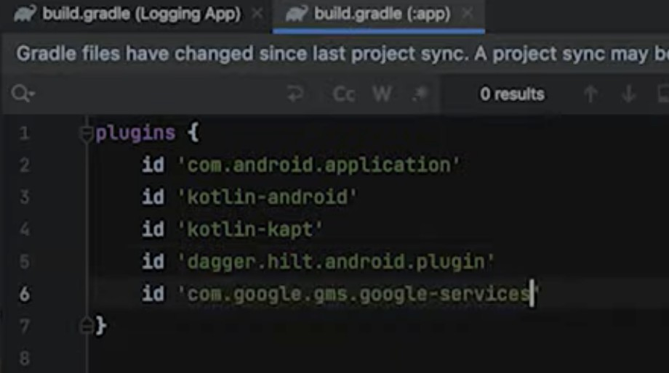
Gradle

Slide 28
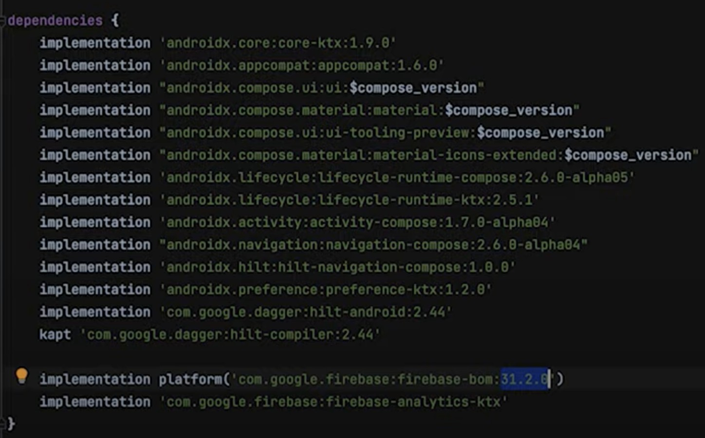
Dependencies

Slide 29
Add Firebase SDK
In your app-level build.gradle file, add the Firebase SDK dependencies. For authentication, you’ll need to include the Firebase Authentication library:
implementation 'com.google.firebase:firebase-auth:21.0.0'

Slide 30
Initialize Firebase
In your Application class or the main activity, initialize Firebase by calling:
FirebaseApp.initializeApp() in the onCreate method
public class YourApplication extends Application {
@Override
public void onCreate() {
super.onCreate();
FirebaseApp.initializeApp(this);
}
}

Slide 31
Authentication Configuration
Enable Sign-In Methods
Go to Firebase Console → Authentication → Sign-in Method
Choose methods like Email/Password, Google, Facebook, etc.Configure credentials as needed
Create Authentication UI
Use FirebaseUI Authentication for a pre-built, customizable UI
OR build a custom authentication UI in an Activity or Fragment

Slide 32
Auth
List<AuthUI.IdpConfig> providers = Arrays.asList(
new AuthUI.IdpConfig.EmailBuilder().build()
);
startActivityForResult(
AuthUI.getInstance()
.createSignInIntentBuilder()
.setAvailableProviders(providers)
.build(),
RC_SIGN_IN
);

Slide 33
Handle Authentication Results
@Override
protected void onActivityResult(int requestCode, int resultCode, Intent data) {
super.onActivityResult(requestCode, resultCode, data);
if (requestCode == RC_SIGN_IN) {
IdpResponse response = IdpResponse.fromResultIntent(data);
if (resultCode == Activity.RESULT_OK) {
// Successfully signed in
FirebaseUser user = FirebaseAuth.getInstance().getCurrentUser();
} else {
// Sign-in failed, handle the error
if (response == null) {
// User canceled the sign-in process
} else {
// Handle other sign-in errors
} } } }

Slide 34
Sign Out
Implement the sign-out functionality when the user decides to log out:
FirebaseAuth.getInstance().signOut()

Slide 35
Enhancements
That’s a basic overview of implementing user sign-in using Firebase in an Android app
You can further enhance your app by adding features like user profile management, account linking, or additional sign-in methods based on your app’s requirements
Make sure to refer to the Firebase documentation for the most up-to-date information and detailed implementation instructions

Slide 36
Any Questions?

